Slide 1
Alexa
Group 7

Slide 2
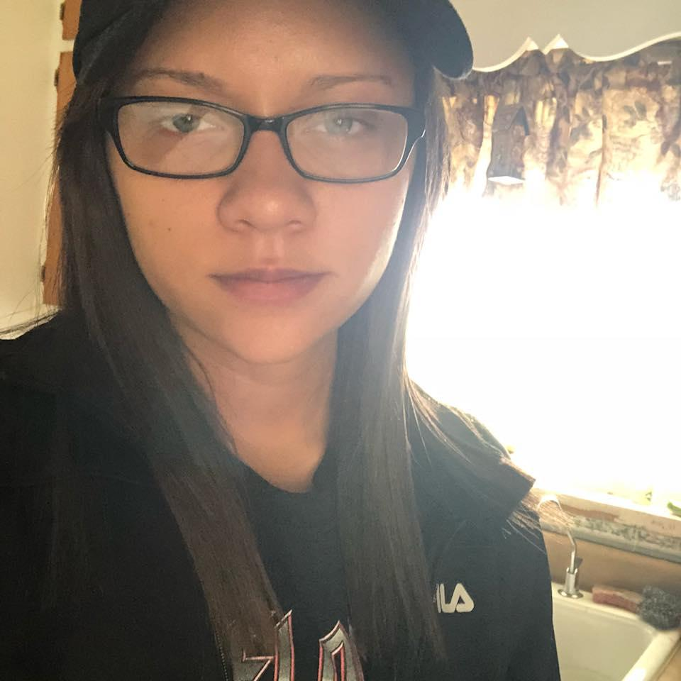
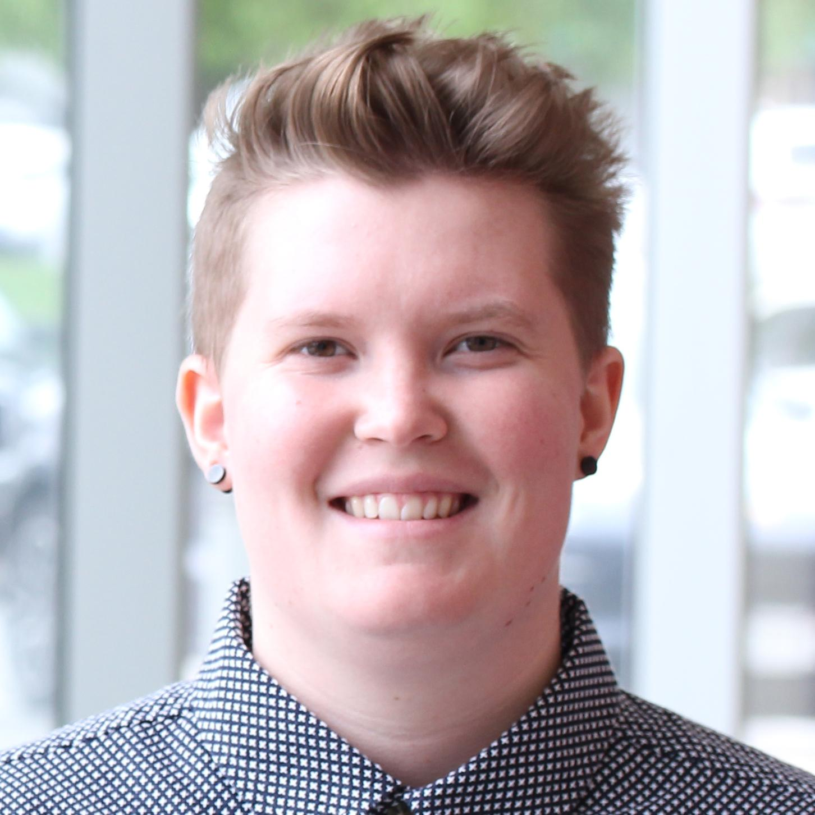
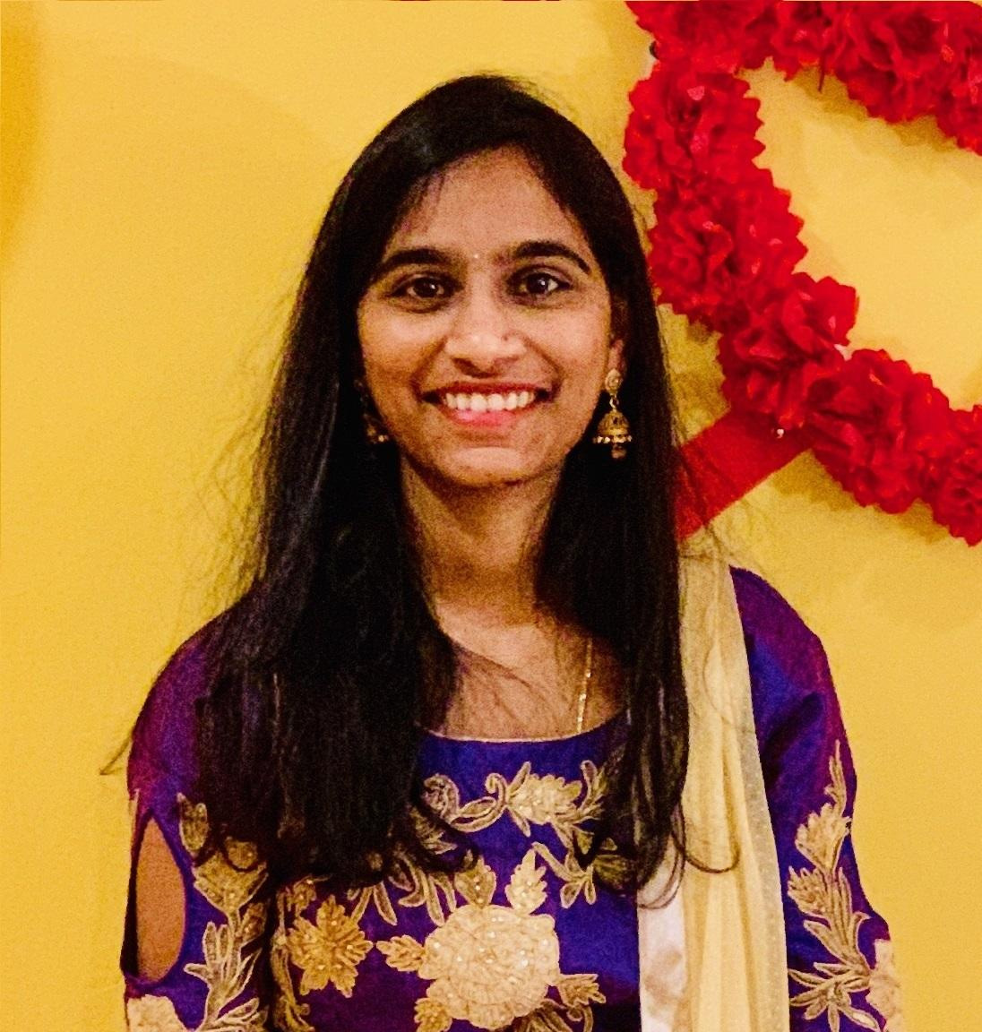
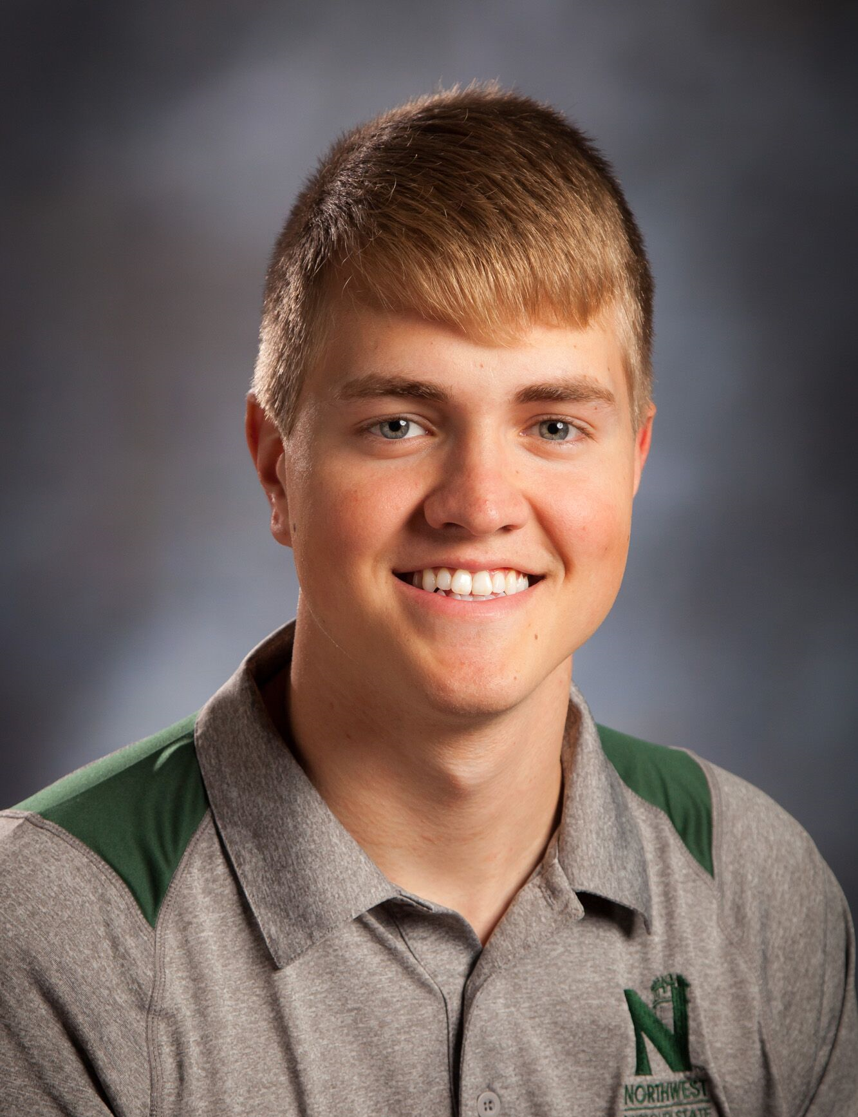
Our Team
Ashley Stanbridge
Kelsie Dibben
Tyler Jacobson
Priyanka Bodapati

Slide 3
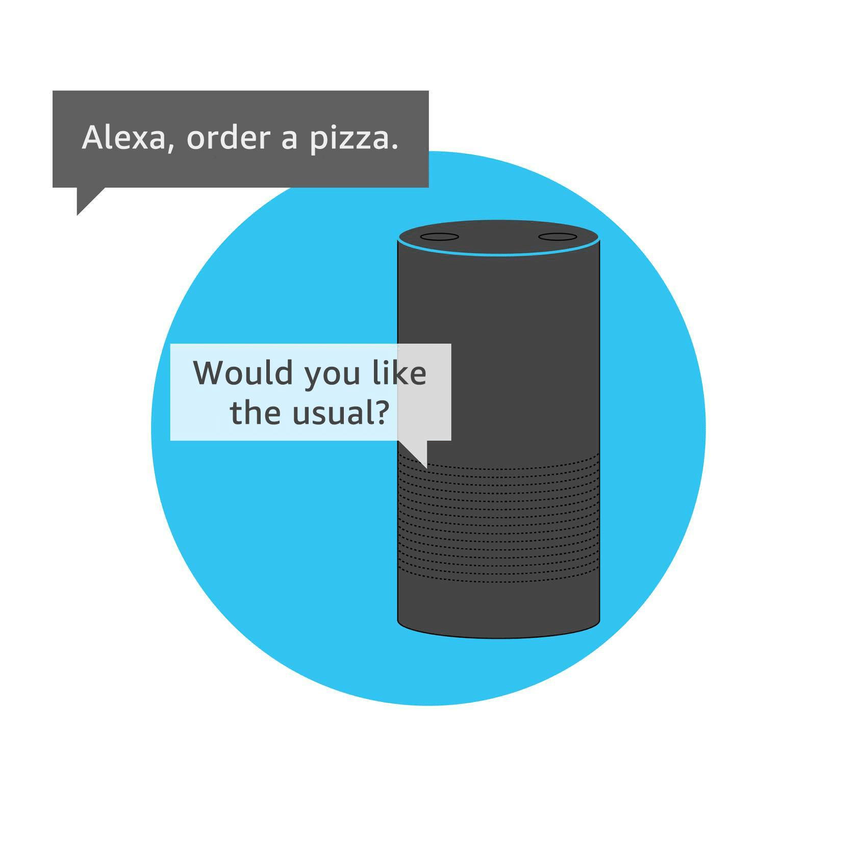
What is it?
Alexa is a cloud-based voice service created by Amazon
It is a virtual assistant that can respond to questions and perform various tasks, such as create a to-do list or listen to music
Alexa operates using skills, which are like apps for Alexa that expand its features
The backbone of a skill is The Alexa Skills Kit (ASK) which is “a collection of self-service APIs, tools, documentation, and code samples that make it easier to start building Alexa skills.”
Skills can be built using a pre-built model or can be completely custom
When building a skill, you define the requests it can handle, the name Alexa uses to identify the skill, called the invocation name, and write the code to fulfil that request
Notes:
Sources: https://developer.amazon.com/en-US/alexa/alexa-skills-kit
https://developer.amazon.com/en-US/alexa/alexa-skills-kit/resources/training-resources/cake-walk/cake-walk-1
https://www.tomsguide.com/us/amazon-alexa-faq,review-4016.html
Image: chapter1-2-echo.png

Slide 4
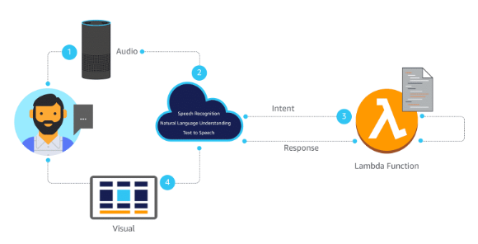
How does it work?
Create a skill, then launch that skill via invocation name.
i.e. open cake walk
Ask whatever you want of Alexa then that request, or utterance, is sent to the Alexa service in the cloud.
The utterance is then processed from speech recognition to text.
Alexa will send a JSON request to handle the intent, which is the action the user wishes to be fulfilled, to an AWS Lambda function in the cloud.
All the Lambda function is doing is executing your code.
Notes:
Source for text and picture: https://developer.amazon.com/en-US/alexa/alexa-skills-kit/resources/training-resources/cake-walk/cake-walk-1
How does it work?
-Explain what a skill is?

Slide 5
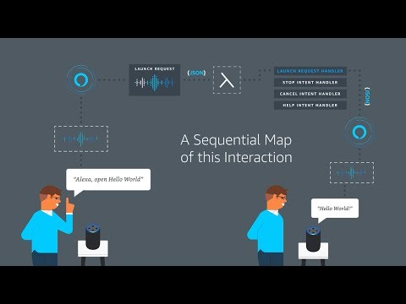
How does it work continued
Notes:
Source: https://developer.amazon.com/en-US/alexa/alexa-skills-kit/resources/training-resources/cake-walk/cake-walk-1

Slide 6
Here’s how you build her
Requirements before building:
Sign up for an account on the Alexa developer console
Design the Voice User Interface
This is where interaction with a web app is possible
Build
Utterances, intents, and slots
Test
Has a built-in Alexa simulator.
Certification and launch
Skill must pass certification, then it will be published in the Alexa Skills Store
Notes:
Note that building the voice UI is much different than building a mobile or web app UI. Here you will need to think about the different ways a user might interact with the voice skill. To try and catch everything, script the user request. I believe if using the course, an endpoint is provided for you.
Definitions:
Utterance - an utterance is a user's spoken request. These spoken requests can invoke a skill, provide inputs for a skill, confirm an action for Alexa, and so on. Consider the many ways a user could form their request.
Intent - An intent represents an action that fulfills a user-spoken request. Intents can optionally have arguments called slots.
Slot value - Slots are input values provided in a user's spoken request. These values help Alexa figure out the user's intent.
Wake word - The wake word tells Alexa to start listening to your commands.
Launch word - A launch word is a transitional action word that signals Alexa that a skill invocation will likely follow. Sample launch words include tell, ask, open, launch, and use.
Invocation name - To begin interacting with a skill, a user says the skill's invocation name. For example, to use the Daily Horoscope skill, the user could say, "Alexa, read my daily horoscope."

Slide 7
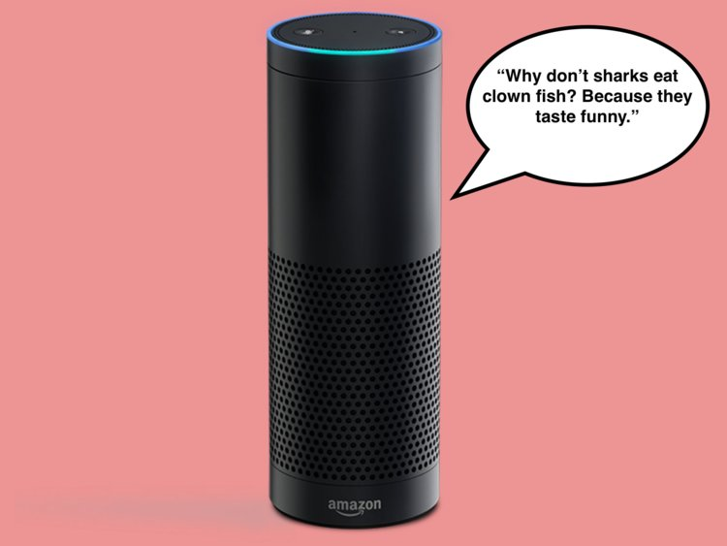
DEMO TIME
Notes:
Make sure to talk about the different handle functions as this is important to how the skill works source: https://developer.amazon.com/en-US/alexa/alexa-skills-kit/resources/training-resources/cake-walk/cake-walk-3
Picture source:
https://www.google.com/url?sa=i&url=https%3A%2F%2Fwww.businessinsider.com%2Feleven-jokes-that-show-off-amazon-alexas-sense-of-humor-2017-10&psig=AOvVaw3OI53Z5ubXzz-xN1PgMD0M&ust=1572997823932000&source=images&cd=vfe&ved=0CAIQjRxqFwoTCPia_9nf0eUCFQAAAAAdAAAAABAK
Picture Address:
https://encrypted-tbn0.gstatic.com/images?q=tbn%3AANd9GcTfVXsZOMk_-_0NlZKtlUdA2RX5Gi90m_xi_EZzr8xJgmkwMYgf

Slide 8
Questions?

